Slide 1
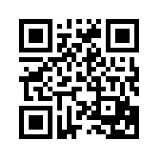
Activating Strategy
A chair will be placed in the middle of the floor. Teacher question: Are there any forces acting on this chair? Invite a student to gently push the chair a short distance across the floor. Ask the same teacher question again. Invite two students to come up and push on the chair from opposite sides. Ask are there any forces acting on this chair? Introduce new question: Why does the chair not move? (Even though there are forces acting on the chair, they are balanced causing the chair to not move.)
Notes:
Instructional Approach(s): Teacher will facilitate student discussion. Elicit student responses. Ask students if they agree or disagree with the answer.

Slide 2
Forces

Slide 3
Essential Question:
How do gravity, inertia, and friction affect the balance of forces?
Standard:
S8P3b. Demonstrate the effect of balanced and unbalanced forces on an object in terms of gravity, inertia, and friction
Notes:
Instructional Approach(s): The teacher should introduce the essential question and the standard that aligns to the essential question

Slide 4
What is a force?
A force is a
push
or pull
Notes:
Instructional Approach(s): The teacher should present the information on the slide while the students record the important information on their notes

Slide 5
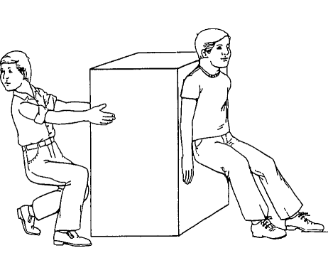
Forces
Forces have size and direction and are expressed in Newtons (N)
Force is always exerted by one object on another object
Balanced forces produce no change in motion
Unbalanced forces produce a change in motion
Notes:
Instructional Approach(s): The teacher should present the information on the slide while the students record the important information on their notes

Slide 6
Forces
If you roll or kick a ball, what happens eventually?
An unbalanced force is needed to change the speed of a moving object. So, what force is stopping the ball?
Notes:
Instructional Approach(s): The teacher should present the illustration. The teacher should ask the class or call on students to answer the question. Click the mouse to reveal the answer.

Slide 7
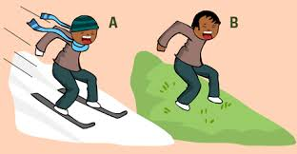
Forces: Friction
Friction is a force that opposes motion between two surfaces.
Notes:
Instructional Approach(s): The teacher should present the information on the slide while the students record the important information on their notes

Slide 8
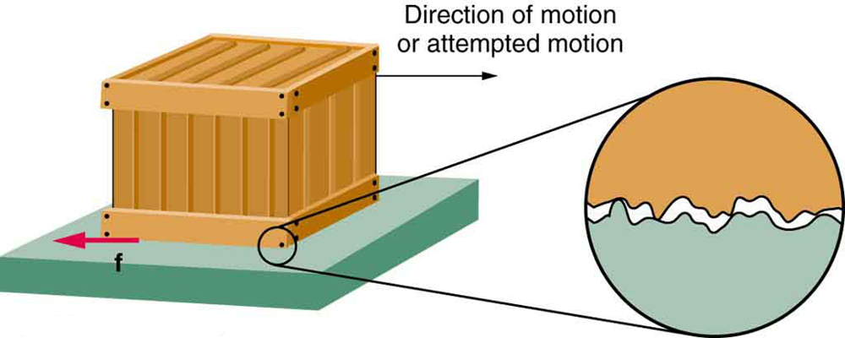
Forces: Friction
Friction occurs because the surface of any object is rough. Even surfaces that feel smooth are covered with microscopic hills and valleys.
Notes:
Instructional Approach(s): The teacher should present the information on the slide while the students record the important information on their notes

Slide 9
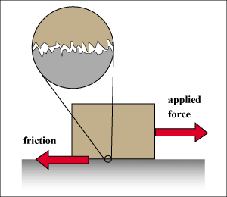
Forces: Friction
When two surfaces are in contact, the hills and valleys of one surface stick to the hills and valleys of the other surface.
Notes:
Instructional Approach(s): The teacher should present the information on the slide while the students record the important information on their notes

Slide 10
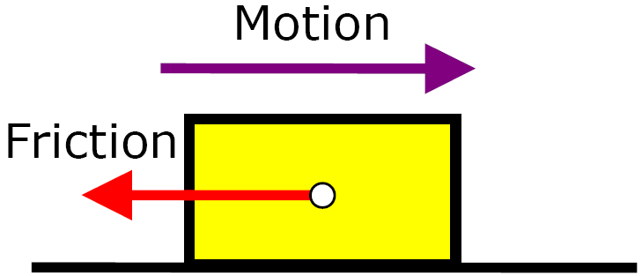
Forces: Friction
The amount of friction depends on factors such as roughness of the surfaces and the force pushing the surfaces together.
Notes:
Instructional Approach(s): The teacher should present the information on the slide while the students record the important information on their notes

Slide 11
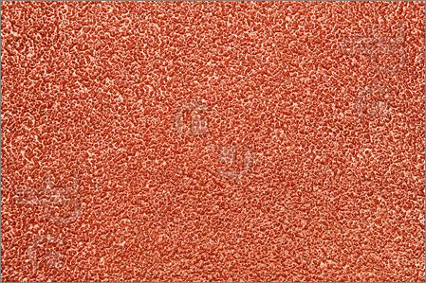
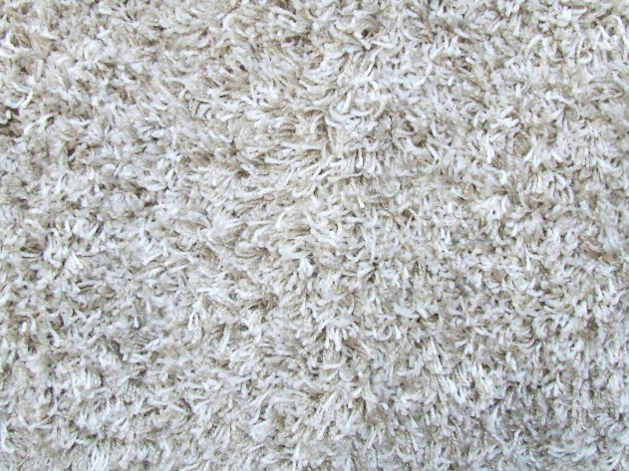
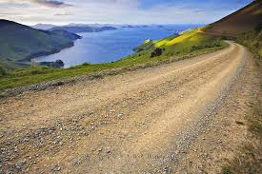
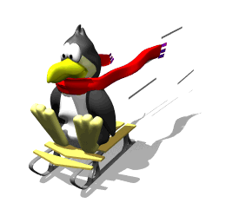
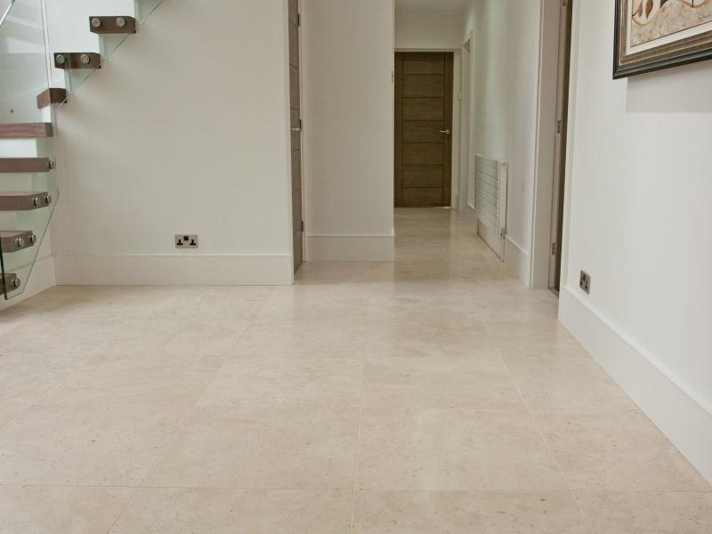
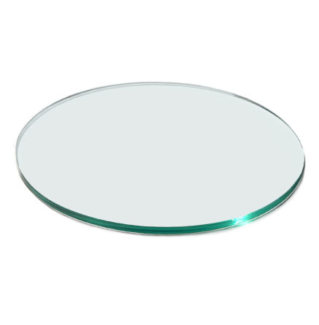
Forces: Friction
Turn to a partner and identify surfaces that may cause more friction.
Carpet
Sandpaper
Gravel
Less Friction?
ICE
Glass
Tile
Notes:
Instructional Approach(s): The teacher should present the illustration. The teacher should ask the class to think-pair-share. Partners can be determined by the students or the teacher can provide more specific directions such as turn to the person directly in front/behind you or to the right/left of you, etc. It may be necessary to have a group of three if you have an uneven number of students. Do not allow more than 30 seconds to 1 minute of discussion time. The teacher should be walking around listening and redirecting discussions as needed. The teacher can briefly discuss student responses. When ready, the teacher can click the mouse to reveal answers.

Slide 12
Friction: Friend or Foe? Handout
Notes:
Instructional Approach(s): Individually, with a partner, or as a class, students read the scenarios and determine whether friction was a friend or a foe in the situation. This could be used as a formative assessment tool.

Slide 13
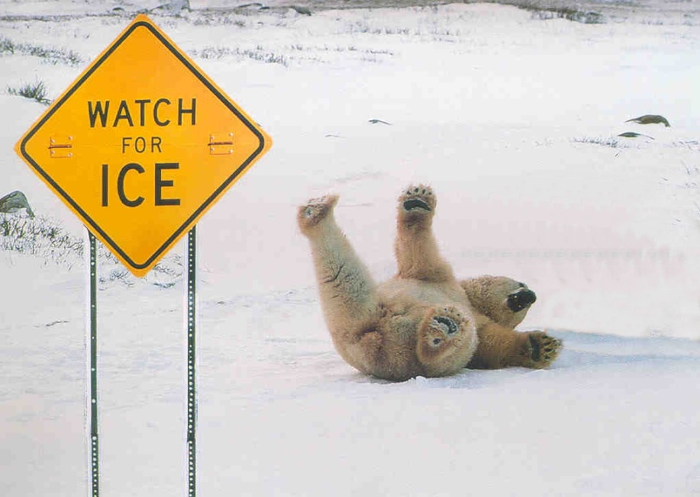
Forces: Friction
Friction is both harmful and helpful. Turn to an elbow partner and identify some examples of friction being harmful and friction being helpful.
Notes:
Instructional Approach(s): The teacher should present the illustration. The teacher should ask the class to think-pair-share.

Slide 14
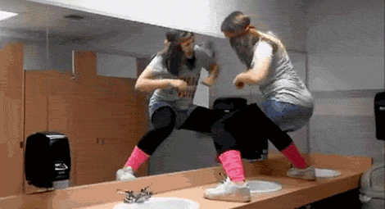
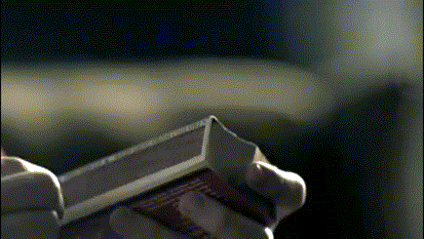
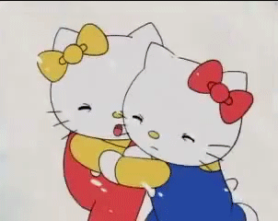

Forces: Friction
Falling
Lighting a match
Breaks and tires on a car
Rubbing your chest, arms, and legs to get warm
Notes:
Instructional Approach(s): The teacher should use the images on the slide to illustrate examples of friction.

Slide 15
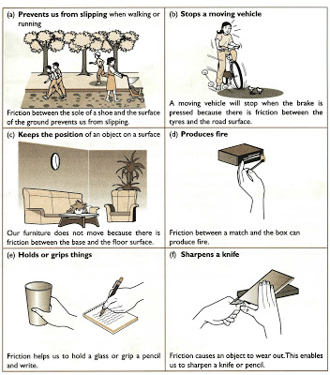
Forces: Friction
Notes:
Instructional Approach(s): The teacher should use the images on the slide to illustrate examples of friction.

Slide 16
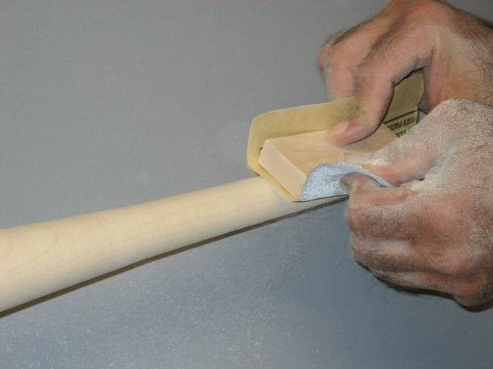
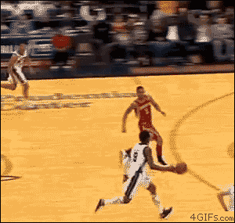
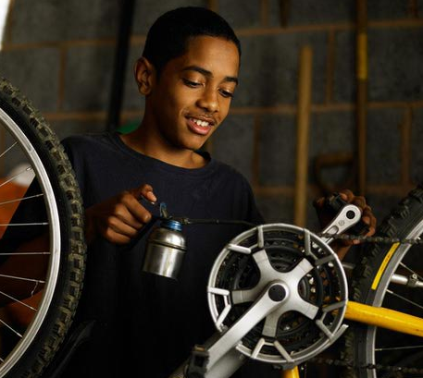
Forces: Friction
Is it beneficial to reduce or increase friction? Why or
Why Not?
Notes:
Instructional Approach(s): The teacher should present the animated slide. The teacher should ask the class or call on students to answer the question. Use the illustrations to discuss whether you want to increase friction or reduce friction in the examples.

Slide 17
Forces: Friction
Which of the following would NOT help you move a heavy object across a concrete floor?
Water, ball bearings, oil, liquid soap, steel rods, foam rubber
Name three common items you might use to increase friction.
Notes:
Instructional Approach(s): The teacher should ask the class or call on students to answer the question. Answer: Ball bearings, steel rods, foam rubber.

Slide 18
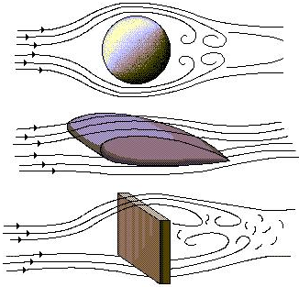
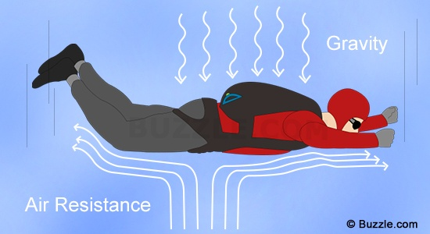
Forces: Air Resistance
Air resistance is a form of friction.
Look at the images below. Why would air resistance be a form of friction?
Notes:
Instructional Approach(s): The teacher should present the information on the slide while the students record the important information on their notes

Slide 19
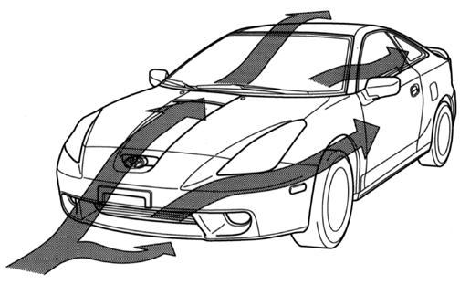
Forces: Air Resistance
Would a school bus or a racing car be affected less by air resistance? Why?
Air resistance depends on the size, shape, and speed of the object.
Notes:
Instructional Approach(s): The teacher should ask the class or call on students to answer the question.

Slide 20
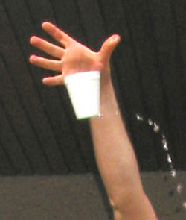
Falling Water Demonstration
http://www.csiro.au/helix/sciencemail/activities/DropCup.html
http://www.thenakedscientists.com/HTML/content/kitchenscience/exp/weightless-water/
What force is acting on the cup and the water?
Notes:
Instructional Approach(s): Teachers either demonstrate the activity, have small groups do the activity outside, or watch a short video clip of the activity.

Slide 21

Gravity
Gravity is a force of attraction between objects that is due to their masses.
All objects experience an attraction toward all other objects. This gravitational force pulls objects toward each other.
Notes:
Instructional Approach(s): The teacher should present the information on the slide. The attraction between objects will be discussed in more depth in the next essential question. For this essential question, we just need students to understand that all objects have the force of gravity pulling them toward the earth which keeps things in place unless an unbalanced force occurs.

Slide 22

Gravity
Compared with all other objects around you, Earth has a huge mass. Therefore, Earth’s gravitational force is very large.
You must apply forces to overcome Earth’s gravitational force any time you lift objects or even parts of your body.
Notes:
Instructional Approach(s): The teacher should present the information on the slide while the students record the important information on their notes

Slide 23
Gravity
Earth’s gravitational force pulls everything toward the center of Earth.
Because of this force, the books, tables, and chairs in the room stay in place, and dropped objects fall to Earth rather than moving together toward you.
Notes:
Instructional Approach(s): The teacher should present the information on the slide while the students record the important information on their notes

Slide 24
Forces Review
There are many different forces which act on objects such as gravity and friction.
If forces are balanced the object doesn’t move
If forces are unbalanced the object will do one of the following things:
  Begin to move
  Stop moving
  Change direction
  Speed up
  Slow down

Slide 25
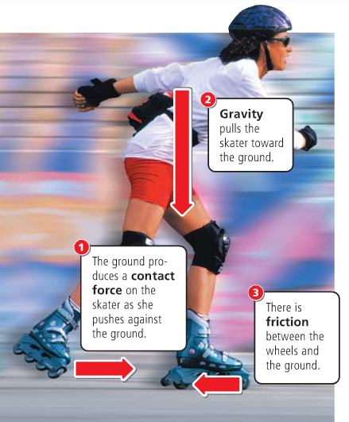
Notes:
Instructional Approach(s): The teacher should use the images on the slide to illustrate examples of gravity and friction.

Slide 26
Forces occur in pairs and they can be either balanced or unbalanced
Notes:
Instructional Approach(s): The teacher should present the information on the slide while the students record the important information on their notes

Slide 27
Balanced Forces
When two forces acting on an object are equal in size, but are opposite in direction, we say the forces are balanced.
Balanced forces do not cause a change in motion.
Notes:
Instructional Approach(s): The teacher should present the information on the slide while the students record the important information on their notes

Slide 28
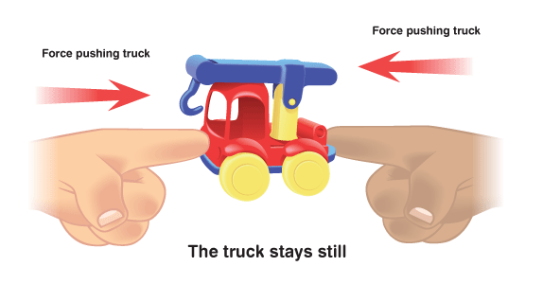
Balanced Forces
Notes:
Instructional Approach(s): The teacher should present the illustration to provide an example of balanced forces.

Slide 29
Force Diagrams
We can show the forces acting on an object in a force diagram.
In a force diagram, the force is shown with an arrow – the larger the arrow, the bigger the force
The arrows in a force diagram also show the direction that the force is acting on
Sometimes, the arrow will be labeled with the size of the force in Newtons (N). A larger number means a larger force.
Notes:
Instructional Approach(s): The teacher should present the information on the slide.

Slide 30
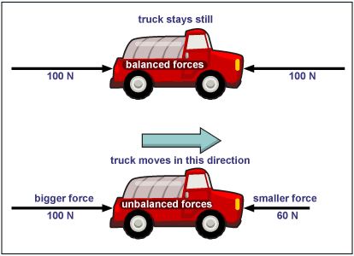
Force Diagrams
Notes:
Instructional Approach(s): The teacher should present the illustration to provide an example of unbalanced/balanced forces.

Slide 31
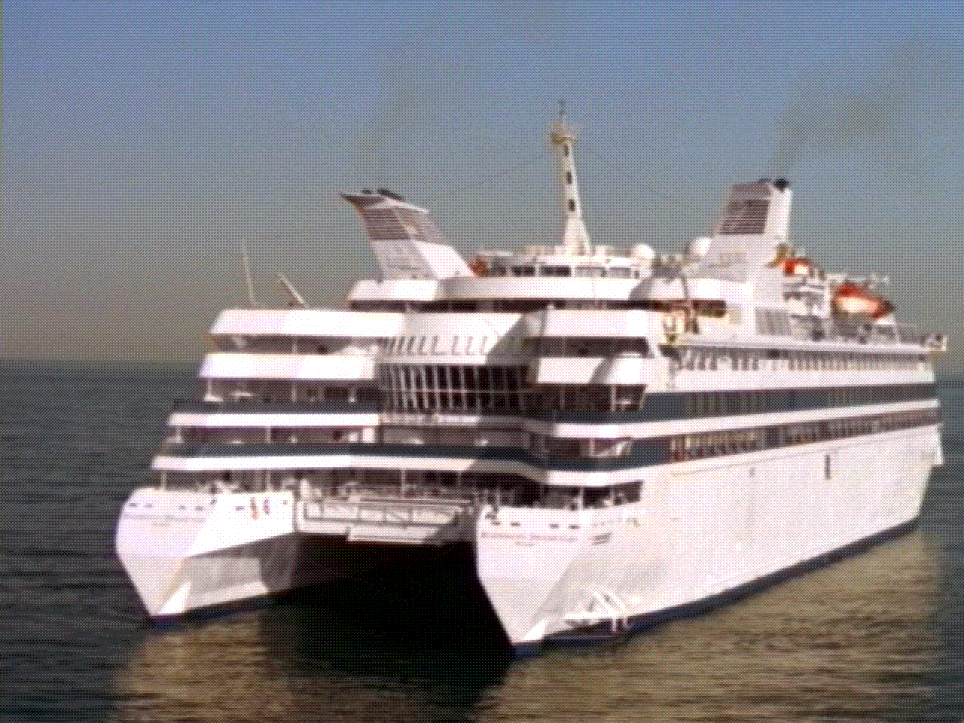
Balanced Forces
The ship is floating on the water, the forces are balanced. Which forces are acting on the ship?
Because Gravity’s force [down] and the water’s force [up] are equal the ship stays afloat.
Water’s
upward force
Gravity
Notes:
Instructional Approach(s): The teacher should present the illustration to provide an example of balanced forces. The teacher should ask the class or call on students to answer the question. Click the mouse to reveal the answer.

Slide 32

Balanced Forces
The vase is resting on the table. It is not moving, therefore the forces must be balanced.
Which forces are acting on the vase?
Have a look around the classroom and name some of the balanced forces in action on different objects.
Gravity
Table’s Upward
Force
Notes:
Instructional Approach(s): The teacher should present the illustration to provide an example of balanced forces. The teacher should ask the class or call on students to answer the question. Click the mouse to reveal the answer.

Slide 33
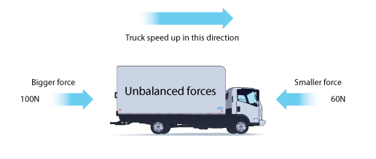
Unbalanced Forces
When two forces are acting on an object and are not equal in size, we say the forces are unbalanced.
Unbalanced forces cause a change in motion by changing the object’s speed or direction.
Notes:
Instructional Approach(s): The teacher should present the illustration to provide an example of unbalanced forces.

Slide 34
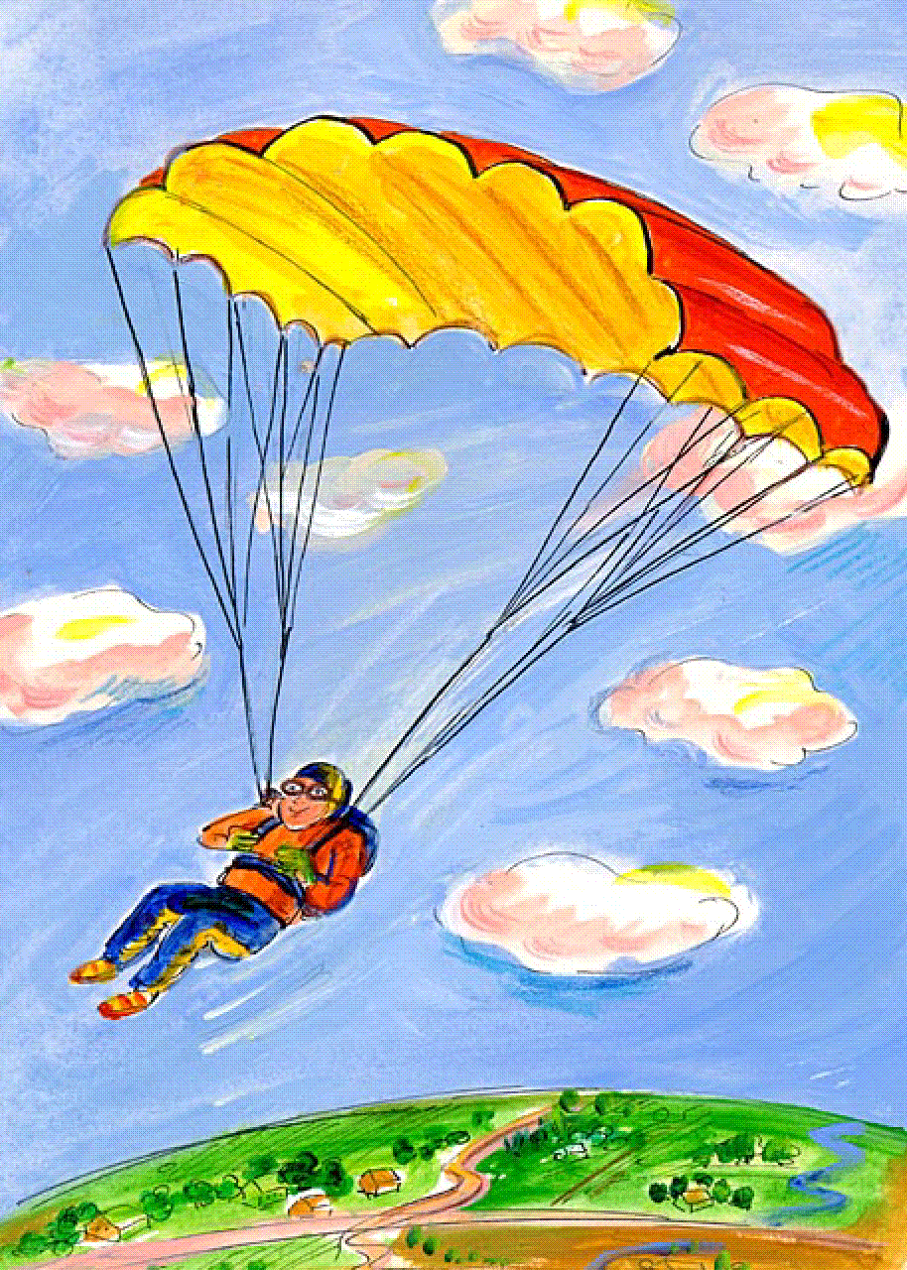
Unbalanced Forces
The man and the parachute are slowly falling to the ground.
Which forces are acting on the parachute?
Which force is bigger? How can you tell?
Air resistance is pushing upwards
Gravity is pulling the man to the ground
Gravity is the bigger force.
We can tell this because the direction of movement of the man and the parachute is the same as the direction of the force of gravity.
Notes:
Instructional Approach(s): The teacher should present the illustration to provide an example of unbalanced forces. The teacher should ask the class or call on students to answer the question. Click the mouse to reveal the answer.

Slide 35
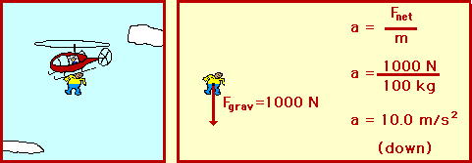
Unbalanced Forces
Notes:
Instructional Approach(s): The teacher should present the illustration to provide an example of unbalanced forces.

Slide 36
Unbalanced Forces
Air resistance is pushing upwards
The same forces are acting on the elephant, but without a parachute there is much less air resistance.
Gravity is a much bigger force. Because there is a bigger difference between the force pulling downwards and the force pushing upwards, the elephant falls much more quickly than a man with a parachute.
Gravity is pulling to the ground
Notes:
Instructional Approach(s): The teacher should present the illustration to provide an example of unbalanced forces. The teacher should ask the class or call on students to answer the question. Click the mouse to reveal the answer.

Slide 37
Unbalanced Forces
The magnetic force is pulling the paperclip upwards
The paperclip is jumping up to the magnet.
Which forces are acting on the magnet? Which is the greater force?
The magnetic force is greater than the force of gravity therefore the paperclip moves in the direction of the biggest force.
Gravity is pulling the paperclip to the ground
Notes:
Instructional Approach(s): The teacher should present the illustration to provide an example of unbalanced forces. The teacher should ask the class or call on students to answer the question. Click the mouse to reveal the answer.

Slide 38
Forces
Each team is exerting a force – what happens if the pulling force produced by each team is equal?
What would happen if the team on the left were able to produce a bigger pulling force than the team on the right?
Notes:
Instructional Approach(s): The teacher should present the illustration to provide an example of forces. The teacher should ask the class or call on students to answer the question. Answer: Balanced force. Unbalanced force.

Slide 39

Unbalanced Forces
Based on the forces shown:
Which arm wrestler will likely win?
Which direction will both arms move?
Notes:
Instructional Approach(s): The teacher should present the illustration to provide an example of unbalanced forces. The teacher should ask the class or call on students to answer the question. Answer: Blue. Left.

Slide 40

Unbalanced Forces
4 N, left
10 N, right
Which direction will the rope move?
Notes:
Instructional Approach(s): The teacher should present the illustration to provide an example of unbalanced forces. The teacher should ask the class or call on students to answer the question. Click the mouse to reveal the answer.

Slide 41
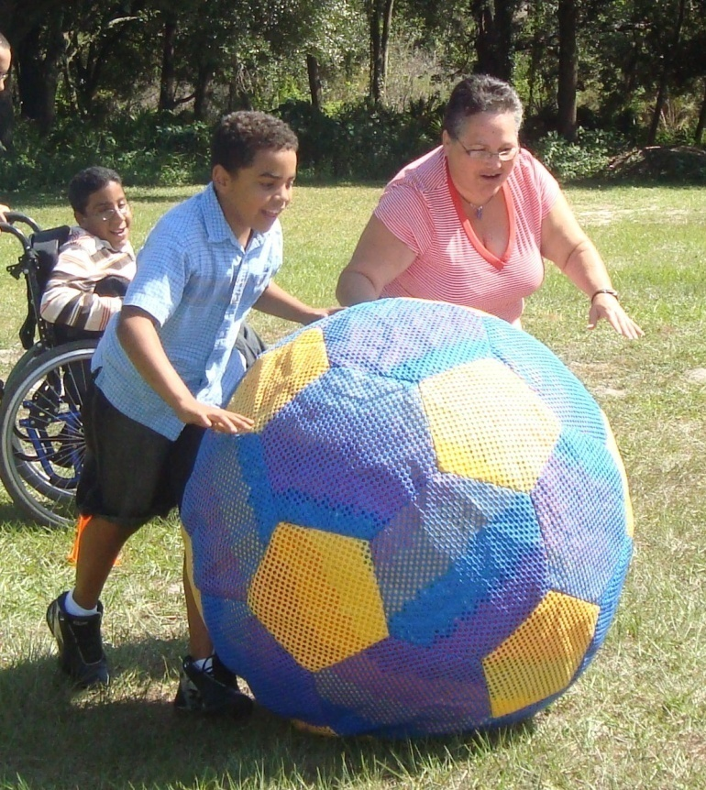



Unbalanced Forces
Which direction will the ball roll?
Notes:
Instructional Approach(s): The teacher should present the illustration to provide an example of unbalanced forces. The teacher should ask the class or call on students to answer the question. Click the mouse to reveal the answer.

Slide 42
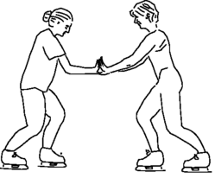
Look at the diagram below. Both women are wearing ice skates on an ice rink. If both women push off from one another, which woman will most likely move the furthest? Why?
Julie will move the furthest because Jennifer’s push will most likely have more force
Jennifer weighs 175 pounds
Julie weighs 130 pounds
Notes:
Instructional Approach(s): The teacher should present the illustration to provide an example of unbalanced forces. The teacher should ask the class or call on students to answer the question. Click the mouse to reveal the answer.

Slide 43
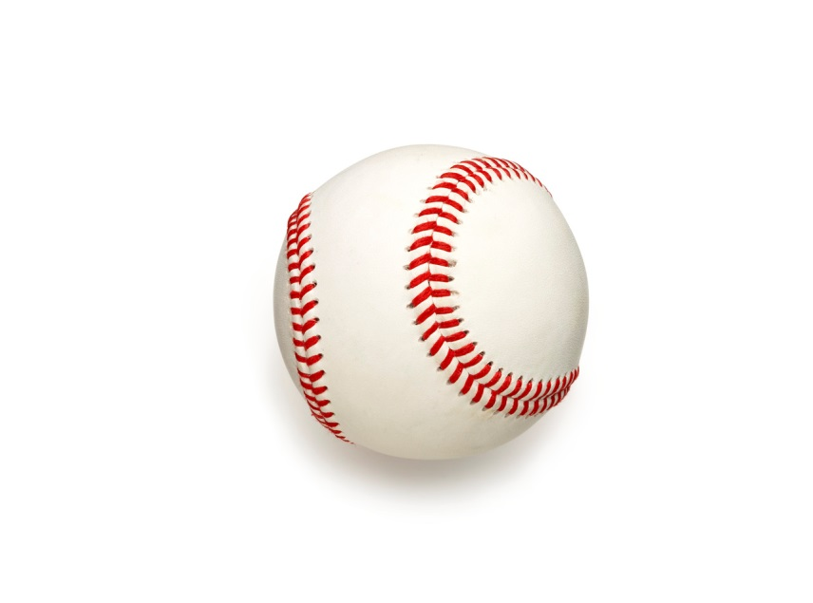
Imagine that you are playing baseball. The pitch comes in and you hit the ball hard.
But, instead of flying off the bat, the ball just drops to the ground. Is that normal?
Notes:
Instructional Approach(s): The teacher should present the information on the slide.

Slide 44
You would probably say no because you know that force and motion are related.
When you exert a force on a baseball by hitting it with a bat, the baseball should move.
Notes:
Instructional Approach(s): The teacher should present the information on the slide.

Slide 45
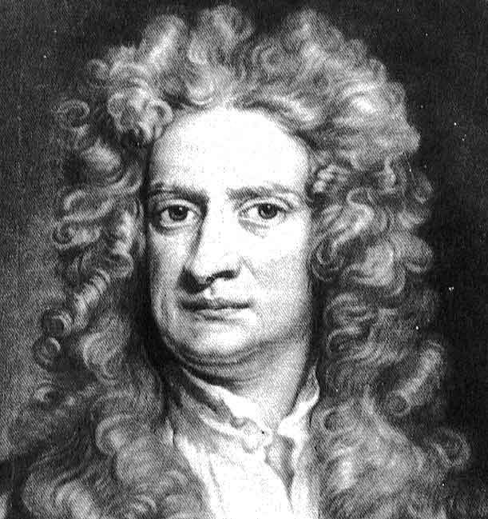
Isaac Newton explained this relationship between force and the motion of an object.
Notes:
Instructional Approach(s): The teacher should present the information

Slide 46

Diving Egg Demonstration
https://www.youtube.com/watch?v=STQRUzalH2M
What happened to the egg? Why?
Notes:
Instructional Approach(s): The teacher should present the links and animations to provide illustrations of the relationship between force and motion. The teacher should ask the class or call on students to answer the question.

Slide 47
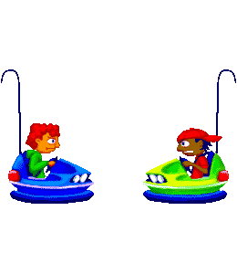
What happens when riding bumper cars? Why?
Notes:
Instructional Approach(s): The teacher should present the illustration. The teacher should ask the class or call on students to answer the question.

Slide 48
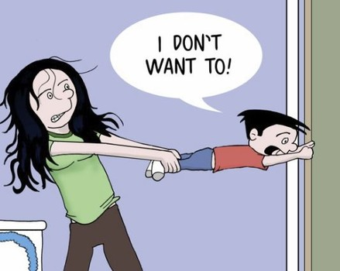
Law of Inertia
Inertia is the tendency of an object to resist being moved or, if the object is moving, to resist a change in speed or direction until an outside force acts on the object.
Notes:
Instructional Approach(s): The teacher should present the information on the slide while the students record the important information on their notes

Slide 49

Law of Inertia
Because of Inertia, an object at rest will stay at rest unless acted on by an unbalanced force.
In other words, objects will not start moving until a push or a pull is exerted on them.
Notes:
Instructional Approach(s): The teacher should present the information on the slide while the students record the important information on their notes

Slide 50
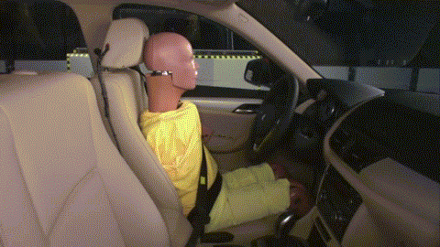
Law of Inertia
Notes:
Instructional Approach(s): The teacher should present the animation.

Slide 51
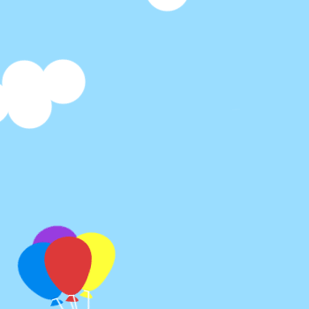
Law of Inertia
An object in motion
remains in motion unless
acted on by an unbalanced force.
The object will continue to move in the same direction with the same speed unless an unbalanced force occurs.
Notes:
Instructional Approach(s): The teacher should present the information on the slide while the students record the important information on their notes

Slide 52
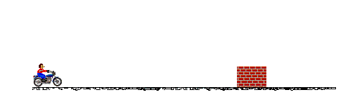
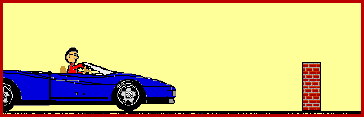
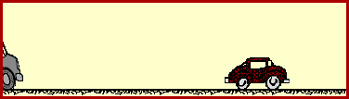
Notes:
Instructional Approach(s): The teacher should present the animations on the slide. There are three animations for the law of inertia. After discussing the first animation, click the mouse and the first animation will disappear while the second animation appears. When finished with the second animation, click the mouse and it will disappear while the third animation appears.

Slide 53
Mass and Inertia
Mass is a measure of Inertia
An object that has a small mass has less inertia than an object that has a large mass
So, changing the motion of an object that has a small mass is easier than changing the motion of an object that has a large mass.
Notes:
Instructional Approach(s): The teacher should present the information on the slide while the students record the important information on their notes

Slide 54

Mass and Inertia
Look at the images below. Which would require more force to move or slow down? Why?
The car because it has more mass therefore more inertia.
Notes:
Instructional Approach(s): The teacher should present the illustration. The teacher should ask the class or call on students to answer the question. Click the mouse to reveal the answer.

Slide 55


Mass and Inertia
Which would require more force to move or slow down? Why?
The bowling ball because it has more mass therefore more inertia.
Notes:
Instructional Approach(s): The teacher should present the illustration. The teacher should ask the class or call on students to answer the question. Click the mouse to reveal the answer.

Slide 56
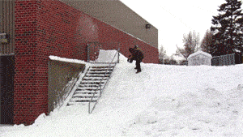
The snowboard is in motion. Based on the Law of Inertia, the snowboard will keep moving right?
What force(s) allow him to snowboard on the brick wall and rail?
Notes:
Instructional Approach(s): The teacher should present the illustration. The teacher should ask the class or call on students to answer the question. Click the mouse to reveal the answer.

Slide 57
Friction and the
Law of Inertia
Objects in motion remain in motion unless acted on by an unbalanced force. Friction is often the unbalanced force that causes objects to slow down and stop moving.
Because of friction, the motion of objects changes.
Notes:
Instructional Approach(s): The teacher should present the information on the slide while the students record the important information on their notes

Slide 58
Study Jams:
Newton’s First Law of Motion: Inertia
Notes:
Instructional Approach(s): The teacher should present the link.

Slide 59
If a moose were chasing you through the woods, its enormous mass would be very threatening. But if you zigzagged, then its great mass would be to your advantage. Explain why.
Formative Assessment Check
Notes:
Instructional Approach(s): This could be used as a formative assessment tool.

Slide 60
Activities on Forces
Shoe Sole Friction Activity
Coin Tower
Hovercraft
Friction Worksheet
Balanced and Unbalance Forces Practice
Forces In Action Worksheet
Forces Activities
Diving Eggs Demonstration Document
Marble Madness
Inertia: Penny in a Cup
Flinker
Notes:
Instructional Approach(s): The teacher should select one or two of the activities to use to reinforce the concept of balanced and unbalanced forces

Slide 61
Summarizer
Notes:
Instructional Approach(s): Each student should complete the summarizer. The teacher should use the summarizer to determine the level of student mastery and if differentiation is needed.

